Slide 1
IPR Term 2 Week 4
T-Tests (part 1)
Dr Hayley Dewe
(Assistant Professor)

Slide 2
Learning Outcomes
After the next three weeks and independent study you should be able to:
Understand the purpose of parametric t-tests (One samples, between-subjects and within-subjects) and when / why to use them.
Understand their non-parametric equivalent tests
Understand how the data are calculated and analysed.
Run all tests competently in JASP – and understand and interpret the output
Write up and interpret the results following APA standards.
Online content: Run all tests using JASP software using the ‘How to’ videos

Slide 3
Lesson Outline
Introduction to t-tests
Types of t-tests (parametric)
Assumptions
Types of t-tests (non-parametric)
Online content: catch up on last week if you haven’t already, and this week: worksheet activity.

Slide 4

Introduction to t-tests

Slide 5
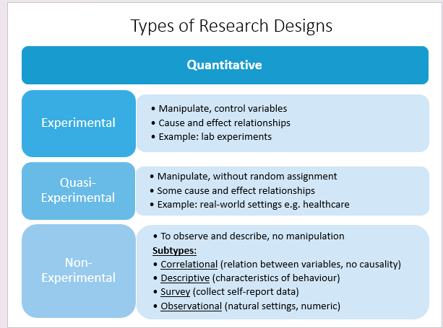

Slide 6
Experimental Design
To determine the relationship between an independent variable (IV) and a dependent (DV) variable.
The IV(s) are manipulated, participants are assigned to different groups or conditions, and the DV is measured (also called the outcome variable).
Definition: Measures the size of the difference between these two groups or conditions (based on the IV manipulation)
Allows us to draw conclusions and cause-and-effect relationships (something that we couldn’t do with correlation)

Slide 7
What is a t-test?
Written as t
Definition: an inferential statistical test used to determine whether there is a significant difference between the means of two groups.
Purpose: assesses whether the average score of a dependent (outcome) reliably differs between two groups or conditions.
E.g., whether stress levels differ between participants who slept 8+ hours compared to those who slept 6 hours.
Test Output:
Calculates an observed test-statistic (t): the size of the difference between group means, relative to variability/noise. Positive or negative (sign indicates direction of the difference)
Corresponding p-value indicates whether the observed t-statistic is statistically significant (if p < α = significant, reject H₀)
Effect size (when selected): size (magnitude) of effect in the population – a more practical interpretation.

Slide 8
What is a t-test?
However, a t-test isn’t just about a cause-and-effect relationship…
It doesn’t just look at the difference between groups… but also their variability.
That is, it depends on how well-controlled our experiment / variables are. We must isolate and measure the effect of our manipulation (IV) on the DV as much as possible, to be confident that our findings are due to the IV and not some other factor
Remember the variability of data? (Term 1, Week 5)

Slide 9
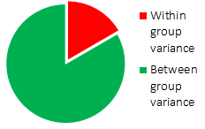
Variability of Data
A difference between two groups might only be meaningful if the scores in each group are consistent (low variability / low noise).
If the data from one or both groups are noisy and moving around a lot anyway (high variability) the average difference between them could just be due to randomness (not your manipulation).
We want our manipulation (IV) to have a consistent effect on all participants. For any difference between groups to be (mostly) explained by our experimental manipulation.
Significant difference between two groups = larger ‘between’ group differences and smaller ‘within’ group variance.

Slide 10
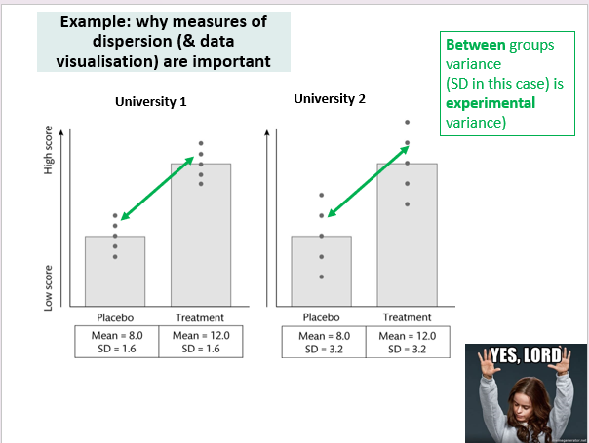
Variability of Data
Treatment vs Placebo in two groups – at two different Universities
At both Universities, there is change between our Treatment vs Placebo groups
= Higher scores in Treatment vs. Placebo (yay!)
So, both Universities had a significant cause-effect!.... Yes??

Slide 11
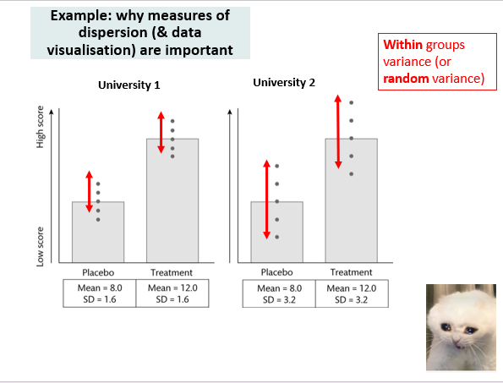
Variability of Data
Actually, NO!
The spread of data within each group, shows the Universities are different.
= University 2 variable / noisy across Placebo & Treatment groups (boo!)
For University 2 we don’t know what’s driving the difference – there’s too much spread / noise, participants overlap. We can’t be sure the cause is treatment.

Slide 12
Variability of Data
There will always be some difference between groups (some within group variance) we cannot control (e.g. natural variation) – even if you test the same people!
But we want our manipulation to have a consistent effect on all participants.
Are any observed changes / effects in the data explained (mostly) by our experimental manipulation (the between group variance)
That is - was the manipulation successful?
Remember we can’t test everyone – we infer or estimate confidence that our findings (manipulations) are a real effect (or rare under the null hypothesis)
We can do this by:
increasing our between-group variance and
decreasing our within-group variance

Slide 13
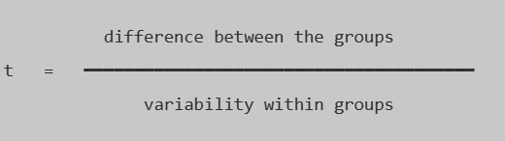
What a t-test tells you
A t-test compares the scores of two groups/conditions, is it a big enough difference compared to the variability (spread) that is found within the group/condition naturally.
That is: is our experimental manipulation (of the IV) causing (significant) changes in the DV?
Once you take into account the variability or possible changes that may occur naturally within groups.

Slide 14
A significant t-test tells you
The greater the difference between groups/conditions compared to the variability = the larger the t-statistic (t) will be.
Large t = statistically significant result
We want a large/extreme t-statistic value (rare / unique) to reject the null hypothesis (which claims there is no significant difference between groups)

Slide 15
The importance of visualising data
Again, this is an important first step: visualise the data to explore the differences between groups/conditions
When dealing with group differences, a boxplot (box and whisker plot) or bar graph is best to:
see difference between the groups so you can compare the range of scores, level of noise etc.
general impressions of whether the groups are similarly distributed (e.g., normal or skewed)
Boxplot = shows the median, quartiles (ranges) and variability
Bar graph = show the mean, and with error bars (standard deviation) shows variability)
Identify outliers - which can change, cause or hide differences

Slide 16
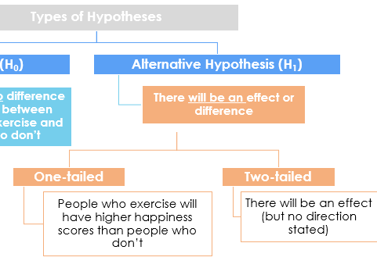
Hypothesis testing
We use t-tests in our hypothesis testing… like Correlation and Chi-square
Alternative, One-tailed (directional) = where the difference lies
(e.g. Group A will have faster RTs than Group B)
Alternative, Two-tailed (non-directional, the default) = a difference exists
(e.g., there will be a difference between Group A and Group B RTs)
Null Hypothesis = no difference in RTs between Group A and Group B

Slide 17
Benefits of t-tests
So why do we use it?
T-tests might not tell us precisely why the groups differ (depends: well-controlled experiments can support causal claims) but they are still incredibly useful and widely used.
It tells us:
Are the two groups different?
In what direction?
How large is the difference?
Is the difference surprising under a ‘no difference’ model
Benefits
Identify differences between groups/ conditions
Test hypotheses about whether groups truly differ
Experimental – controlled conditions
Cause-and-effect interpretations (size of the effect)
Make predictions about expected group differences (e.g. treatment vs control)
Starting point for additional / other experiments, or other possible interactions

Slide 18
2. Types of
t-test
(Parametric)

Slide 19



Types of t-test
Depends on your design and research question:
Let’s say we want to investigate a new exercise programme in Durham, and explore whether exercise makes you happy?
Independent variable
Exercise
Dependent variable
Happiness
Yes
Scale
e.g., 1-20
20 = very happy
No

Slide 20
Types of t-test
Hang on! Did you say categories? So why not use a Chi-square? We use Chi-square when BOTH variables are categorical!
Depends on your variables:
identify an independent variable (IV) – that you manipulate (e.g. treatment vs placebo) or a grouping variable in non-experimental designs (e.g. gender)
→ this is categorical / nominal (e.g. placed in Group 1 or Group 2)
→ you can split ordinal data if it’s meaningful & strong theoretical reason/clear e.g., high vs low scorers (groups) on a test
identify a dependent variable (DV) – your outcome, what you measure (e.g. happiness ratings)
→ this is continuous: interval or ratio data (e.g., RTs, happiness scores, memory recall)
You can use t-tests on Ordinal data (e.g. Likert scales) but like I’ve said before: depends on variable, if order has meaning, the scale/range/spread is approx. interval and normal.

Slide 21

Types of t-test
→ It also depends on if your data meet the assumptions (later):
For now, I’ll focus on when the data has met the assumptions – so I’ll first introduce you to PARAMETRIC of t-tests then move on to their NON-PARAMETRIC equivalents.

Slide 22
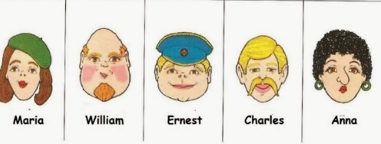
Types of t-test
Depends on your research design:
Who are the participants? How many groups do you have?
Is a person assigned to one group / condition – or do they complete everything?

Slide 23

Does exercise make you happy?
Types of t-test
One-samples t-test
(Parametric)
One group of participants take part in the study in one condition.
Compare mean of group to a known, reference or hypothesised population.
(like a Chi-square Goodness of fit test - with continuous, not categorical data)
Group 1: Happiness ratings collected in a group of people who have completed the exercise programme
COMPARED TO
Reference: Compare to a standard value / general levels of happiness in the population (e.g. different region)

Slide 24
Does exercise make you happy?
Types of t-test
Paired-samples t-test
(Parametric)
One group of participants takes part in the study under two different conditions.
Compare the mean of the group when they do condition A against when they do condition B.
(also called repeated measures or within-subjects test or design)
Group 1: Happiness ratings collected in a group of people after 1 month of exercise
COMPARED TO
Group 1: Happiness ratings for the same group, after 6 months on the exercise programme

Slide 25
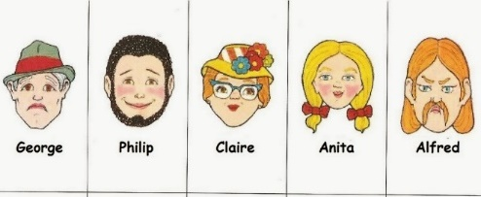
Does exercise make you happy?
Types of t-test
Independent-samples t-test
(Parametric)
Two different groups of participants take part in the study under different conditions.
Compare the means of participants in Group A compared to the means of participants in Group B.
(also called between-subjects test or design)
Group 1: Happiness ratings collected in a group of people who did the Aerobic exercise programme
COMPARED TO
Group 2: Happiness ratings collected in a second group of participants who did the Strength exercise programme

Slide 26
The t-test family tree
How many groups or conditions in your IV?
Two
One
Who are the participants?
Same participants in each condition
Different participants in each condition
Paired t-test
Independent t-test
One-sample t-test

Slide 27
Variability calculated slightly differently depending on t-test!
One-Samples t-test:
Difference: between the mean of a single group and a known or hypothesised population
Variability/noise: variability within the sample, adjusted for sample size.
Paired Samples t-test
Difference: the mean difference between two measures from the same group
Variability/noise: in the difference between scores/measures (how much each person changed), adjusted for sample size
Independent Samples t-test
Difference: the means of two independent groups
Variability/noise: pooled within-group variability, adjusted for two sample sizes

Slide 28
3. Assumptions

Slide 29
Assumptions
REMEMBER from last week: before running a test (e.g. t-test), certain assumptions must be met.
If assumptions are met (or approximately meet them), we run a standard version of the analysis test = called Parametric tests.
If data don’t meet the assumptions = we use a Non-Parametric version of the tests (less strict version, fewer assumptions to meet).
→ there’s standard assumptions that apply to all t-tests (one-samples, paired-samples, independent-samples) and one that only applies to one type!

Slide 30
Assumptions of t-tests
Normality
Data are approx. normally distributed and follow a normal distribution. Independent-samples: both groups are normal. Paired-samples = the difference scores should be normal.
Each participant’s score must not influence / depend on the score of another participant. E.g., participants’ scores don’t affect other participants’ responses. Or in a paired design, each pair of scores is independent from all other pairs.
Homogeneity of variance
For Independent-sample t-test only: the variance (spread of data) should be approximately equal in the two groups (as discussed). If violated → use Welch’s t‑test (gives you corrected values).
Independent observations
Type of data & Outliers
Not strictly assumptions but important. Type of data: IV = categorical. DV = continuous (interval or ratio – or ordinal). Outliers: good practice to check / cutoffs e.g., (z > +3)

Slide 31
Assumptions of t-tests
How to check
Normality
Data are approx. normally distributed and follow a normal distribution. Independent-samples: both groups are normal. Paired-samples = the difference scores should be normal. Visually – distributions and Shapiro-Wilk test in JASP.
Each participant’s score must not influence / depend on the score of another participant. E.g., participants’ scores don’t affect other participants’ responses. Or in a paired design, each pair of scores is independent from all other pairs. Design & Data collection level
Homogeneity of variance
For Independent-samples t-test only: variance (spread of scores) should be approximately equal in the two groups (as discussed). Levene’s test in JASP. If violated → use Welch’s t‑test (gives corrected values).
Independent observations
Type of data & Outliers
Not strictly assumptions, but important checks. Type of data: Researcher checks. Type of data: must have meaningful order. Outliers: good practice to check / criteria. Visual inspection and judgement, identify in JASP plots – try to diagnose first (error or variation)

Slide 32
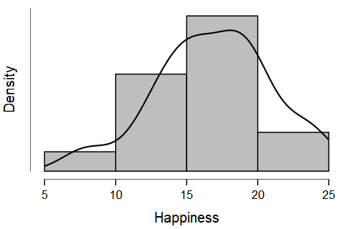
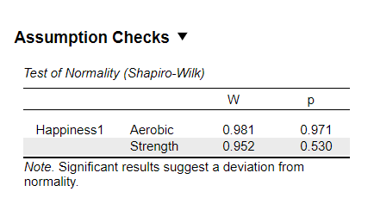
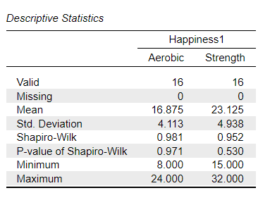
Assumption Checking
Normality
Visual inspection
In JASP: Analysis (t-test)
If p-value of the Shapiro-Wilk test is smaller than alpha value
p < .05 = significant, data are not consistent with coming from a normal population (reject normality)
Often data are not normal – it depends how extreme. If the data are very skewed/clearly non-normal, and other assumptions are violated = use a Non-Parametric test.
In JASP: Descriptives

Slide 33
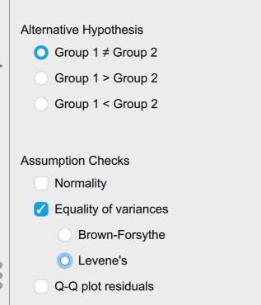
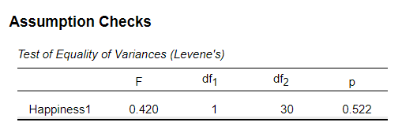
Assumption Checking
Homogeneity of variance
In JASP: Analysis (Independent-samples t-test only)
Select Levene’s:
Test Output:
Like the Shapiro-Wilk test of normality, if the p-value is smaller than alpha, p < .05 = significant.
Suggests the variance between the two groups are significantly different from each other = assumption violated/not met.
Ideally: we want a non-significant result (as above)

Slide 34

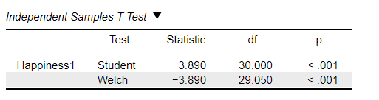
Assumption Checking
Homogeneity of variance
BUT if violated, select ‘Welch’ – a Welch’s corrected independent-samples t-test (adjusts values slightly)
Welch in the test output: alongside (or instead of) and is reported and interpreted the same – (just add “Welch corrected” because homogeneity of variance assumption was violated)

Slide 35
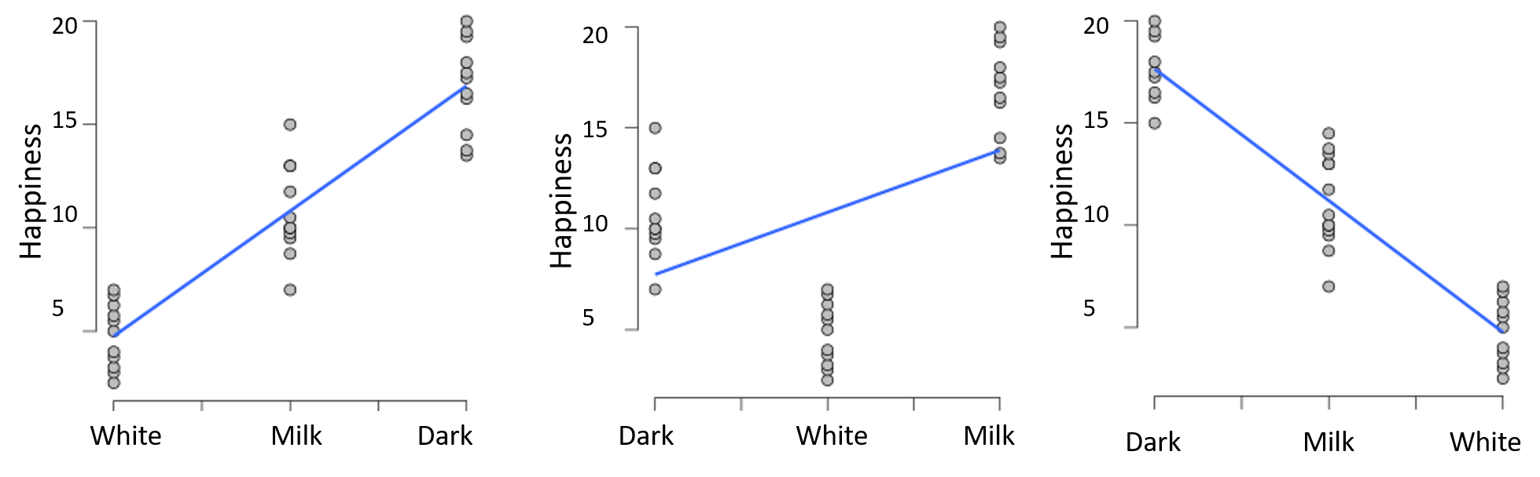
Assumption Checking
Type of Data
IV: categorical / nominal
DV: Interval or ratio
But it can also be Ordinal data e.g. Likert scales) – check the scale, range, spread etc.
And it must have a meaningful order (consider interpretation)
e.g. remember from last week: results change depending on how it’s plotted, type of chocolate has no meaningful order!
Type of Chocolate
Type of Chocolate
Type of Chocolate

Slide 36
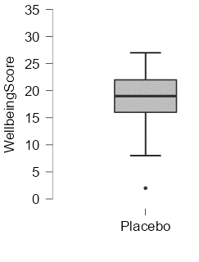
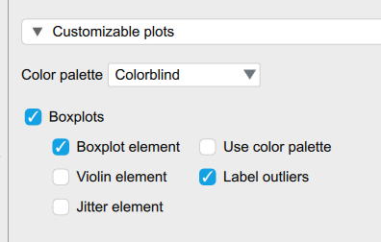
Assumption Checking
Outliers
Visually or in JASP
e.g. boxplot, select label outliers
But it doesn’t mean they should automatically be deleted (judgement, how extreme, sample size, if other assumptions are met etc)

Slide 37
4. Types of
t-tests
Non-parametric equivalents

Slide 38
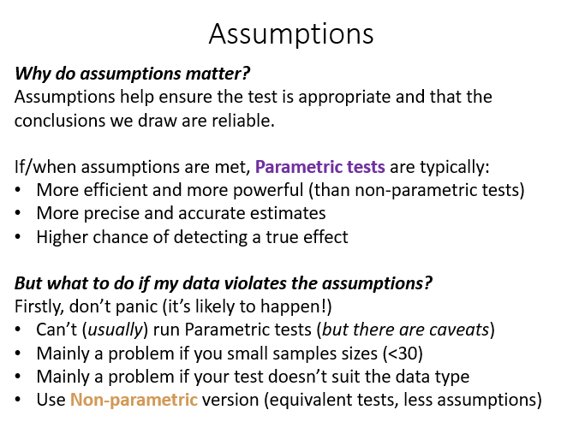
Non-Parametric t-tests
Used if one major / most assumptions have been (severely) violated
Parametric tests have equivalents – they slightly differ in the way they’re calculated.
Non-parametric tests transform the data so it’s appropriate for analysis:
Typically, rank the raw data / scores from lowest to highest (sometimes raw scores will be ‘tied’ in a position too e.g., joint ‘last place’).
↑ from last week, same applies

Slide 39
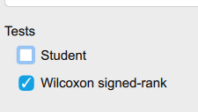
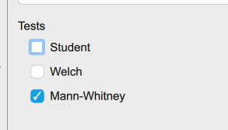
Non-Parametric equivalent t-tests!
One-Samples t-test:
Wilcoxon signed rank test
Paired Samples t-test
Wilcoxon signed rank test
Independent Samples t-test
Mann-Whitney U test

Slide 40
Variability calculated slightly differently depending on t-test!
Still calculated in a very similar way / same concept!
One-Samples t-test:
Difference: between the median of a single group and a known or hypothesised population
Variability/noise: variability in the ranked differences within the sample, adjusted for sample size.
Paired Samples t-test
Difference: the median change between two measures from the same group
Variability/noise: in the ranked differences between scores/measures (how much each person changed), adjusted for sample size
Independent Samples t-test
Difference: if one group has higher ranks than the other group
Variability/noise: variability in the combined rank ordering, adjusted for two sample sizes.

Slide 41
Parametric vs Non-Parametric tests
Whether it’s Parametric or Non-Parametric doesn’t matter too much!
Both are run in similar ways, produce very similar outputs
Both are important / relevance and have the same interpretations.
One main difference is when visualising / presenting the data:
Parametric tests
report mean and standard deviation
use a bar chart or boxplot
Non-parametric tests
report median and IQR (interquartile range) or min/max
use a boxplot box and whisker plot or violin plot (bar charts can hide distribution and don’t match statistics / test used)

Slide 42
Updated t-test family tree
How many groups or conditions in your IV?
Two
One
Who are the participants?
Same participants in each condition
Different participants in each condition
Parametric assumptions met?
Parametric assumptions met?
Parametric assumptions met?
Yes
No
Yes
No
Yes
No
Paired t-test
Wilcoxon signed rank test
Independent t-test
Mann-Whitney U test
One-sample t-test
Wilcoxon signed rank test

Slide 43
Parametric vs Non-Parametric tests
Feature | Parametric tests | Non-Parametric tests
Assumptions | Required (variance). Fairly robust to mild violations (e.g. if N > 30 per group) | Fewer or no assumptions required (independent observations is still required)
Data Type | Continuous data - Interval or ratio (or Ordinal data) | Ordinal data or data that violates assumptions
Use when | Data are (approximately) normally distributed | Data can be non-normal, skewed or contain outliers
Power | More powerful (when assumptions are met) | Less powerful (but more robust and flexible in non-normal conditions)
Effect size | Better at detecting smaller effect sizes if they exist | Rank-based or probabilistic: may require larger effects to reach significance
Descriptives | Compare group means | Compare group medians or distribution / position of ranks
Interpretation | Of mean differences | Differences in ranks of ordered data
Graph | Bar graph (common) or boxplot Mean and SD | Boxplot (common) or violin plot Median and IQR

Slide 44
ONLINE CONTENT
Catch up on Correlation if you missed it!
(before you move on to running t-tests!)
T-tests worksheet

